Slide 1



TRAVEL TIDE
USER BEHAVIOR CLASSIFICATION & METRICS ANALYSIS
Comprehensive Insights on User Travel Patterns for 2023
Presented by: [Rama Alhomsi]
Date: [6/9/2024]

Slide 2
Agenda
1
Objective & Data Sources
2
User Segmentation & Classification
3
Flight & Hotel Metrics
4
User Segmentation Overview
5
Gender-based Travel Preferences
6
Key Insights & Recommendations

Slide 3

Objective
Goal
To classify users based on their travel and booking behaviours using metrics from flight, hotel, and browsing data. This will help in identifying key user segments, understanding their preferences, and driving personalized marketing strategies.

Slide 4

Key Data Tables:
Sessions – Records of user interactions (clicks, session durations, conversions).
Flights – Information on flight reservations, discounts, distances, and baggage specifics.
Hotels – Details regarding hotel bookings, nights stayed, room types, and overall expenses.
Users – Demographic data about users (age, location, marital status, children).
Behavioral Metrics – Categorization of users according to their travel habits and preferences (displayed in Tableau visualizations).
Data Sources

Slide 5

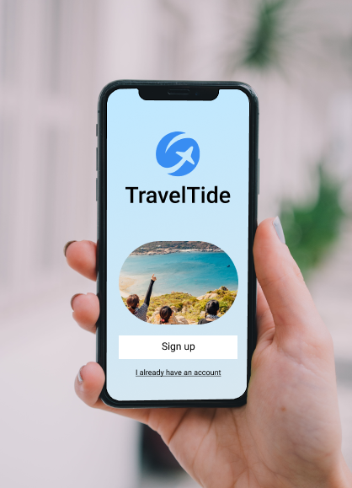


Process Overview
Key Steps:
Filter frequent users (7+ sessions).
Calculate detailed flight metrics (discount usage, distance, and baggage).
Analyze browsing behavior (session time, clicks, and conversion rates).
Evaluate hotel preferences (spending, room bookings).
Create indices (Flight, Hotel, Browsing, Bargain Hunter).
Classify users into distinct groups based on Tableau dashboard insights.

Slide 6
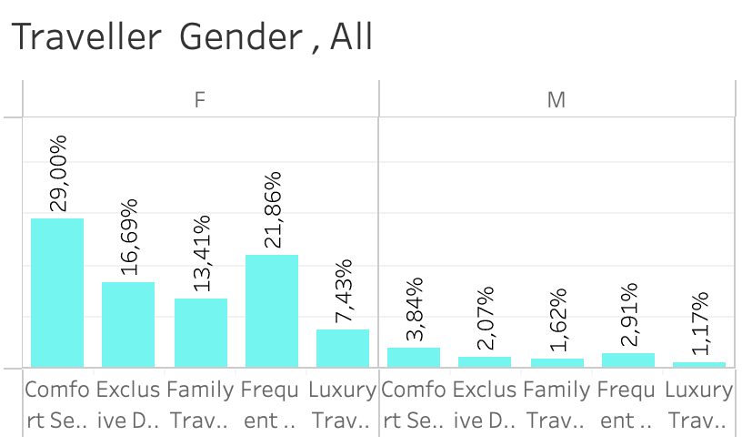
Primary User Groups (Percentage Breakdown):
Comfort Seeker: 29,00% (Female), 3,84% (Male)
Exclusive Discount Lover: 16,69% (Female), 2,07% (Male)
Family Traveler: 13,41% (Female), 1,62% (Male)
Frequent Traveler: 21,86% (Female), 2,91% (Male)
Luxury Traveler: 7,43% (Female), 1,17% (Male)
User Segmentation Overview
Main User Groups (by Percentage):
Insights:
The Comfort Seekers group is the most significant, while Luxury Travelers are the smallest.
There is a smaller proportion of males in the Luxury Travelers group, with an equal representation of genders in both groups.

Slide 7
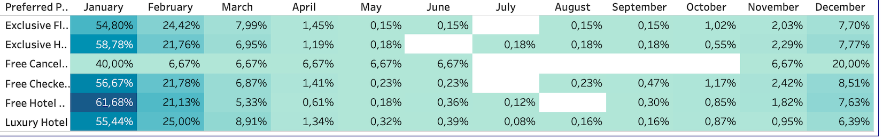
Flight & Hotel Metrics
Flight Preferences:
Preferred Perks by Month (January to December):
Exclusive Flight Discounts: Peaks in January (54.80%), declines throughout the year.
Free Cancellation: Stable at 6.67% throughout the year, with a surge to 20% in December.
Free Checked Bags: Starts high in January (56.67%), showing consistent but declining interest.
Hotel Metrics:
Hotel bookings and profitability are highest among frequent users, with substantial spikes during later months of the year (October–December).

Slide 8


Gender Analysis
Traveler Preferences by Gender:
Female Users:
Dominates the Comfort Seeker and Frequent Traveler segments.
29.00% of female users prefer Comfort Seeker perks.
Male Users:
Show a stronger inclination towards Comfort Seekerl, with 3.84% falling into this category.
Males are less represented in Luxury Traveller (1.17%).
Insights:
Gender preferences show females and males prioritising comfort, while away towards luxury experiences.

Slide 9

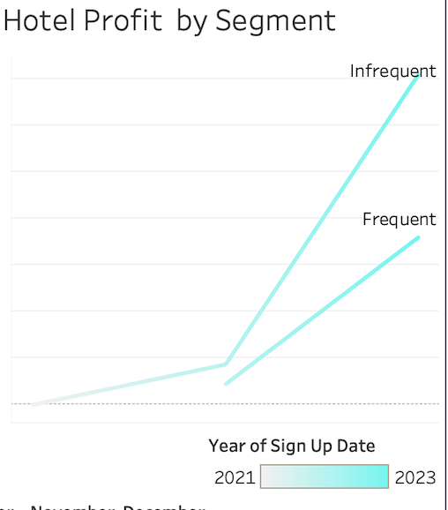
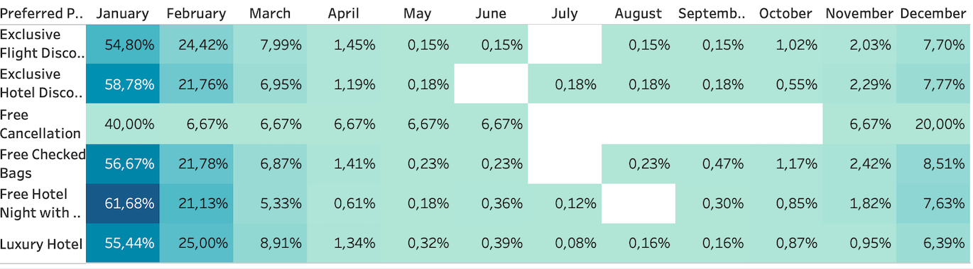
Hotel Profit Segmentation
Hotel Profitability by Segment:
Frequent Users drive the majority of the hotel's profit across segments.
Hotel profits show a significant rise towards the end of the year, indicating that seasonality and holiday bookings play a critical role.
Sign-Up Date Analysis: Users who signed up in 2023 demonstrate higher hotel profitability compared to older sign-up cohorts.

Slide 10
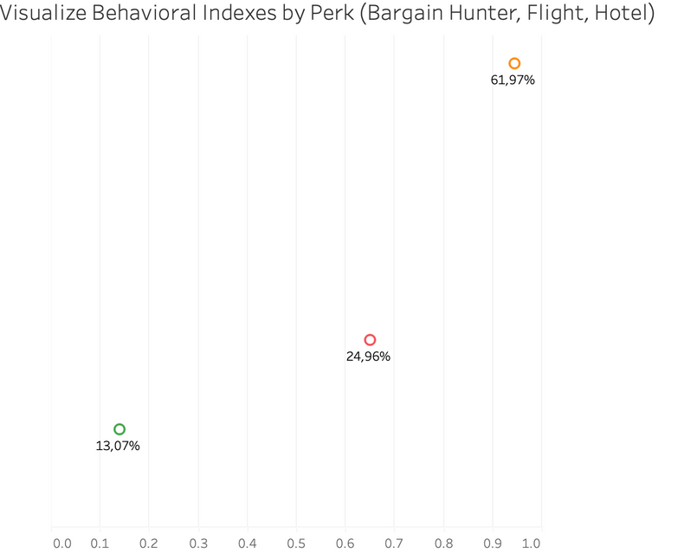
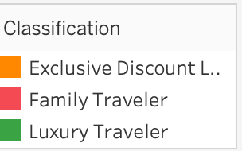
Preferred Perks & Trends
Top Preferred Perks:
Exclusive Flight Discounts: Peaks early in the year with 54.80% of users in January, followed by a decline.
Free Checked Bags: Consistently popular across months, with notable peaks in January (56.67%) and December (8.51%).
Luxury Hotel: Preferred by high-spending users, with steady interest rising from 0.87% in October to 6.39% in December.

Slide 11



Classification Categories:
Luxury Traveler – Highest hotel spending,
Bargain Hunter – Seeks discounts, peaks early in the year.
Frequent Traveler – Travel intensity concentrated in the Female segment. throughout the year.
Comfort Seeker – Dominated by both Gender users, and largest segment in both genders.
Family Traveler – Seen more in the male demographic.
User Classification

Slide 12

Key Insights & Recommendations
Comfort Seekers
Exclusive Discount Lovers
Create campaigns focused on convenience, such as comfort-oriented travel packages.
Target them with seasonal discount offers, particularly at the start of the year when demand peaks.
Luxury Travelers
Frequent Travelers
Offer premium services and loyalty programs targeting high-end hotels and first-class flights.
Focus on reward programs, encouraging continuous engagement through frequent flyer miles and complimentary services.

Slide 13
Conclusion
Behavioral Segmentation offers
1
valuable insights into user travel preferences and helps in driving personalized offers.
2
Seasonality
plays a significant role in user engagement and preferences, particularly around hotel bookings and perks.
3
Targeted marketing strategies
should leverage these insights to optimize conversions and maximize user satisfaction.

Slide 14
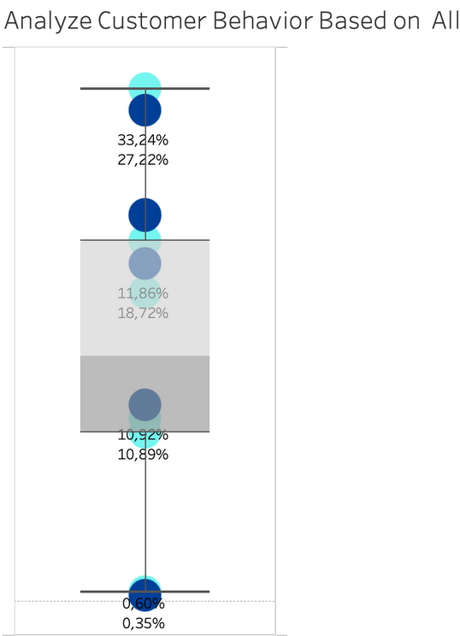
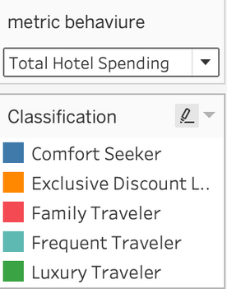
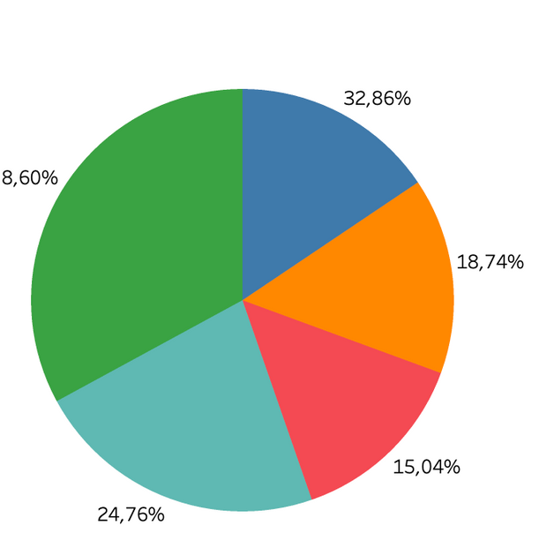
Questions
Q&A
Thank you for your attention!
Let’s discuss any questions or further details you'd like to explore.

